Slide 1

VECTOR CONTROL OF DFIG SEMINAR PRESENTATION SARDAR PATEL COLLEGE OF ENGINEERING u
By,
Ninad Kiran Gaikwad
ME-Electrical
Roll No. 06

Slide 2
QUICK FACTS ABOUT WIND ENERGY GENERATION
Wind power capacity of the world 336 GW
Wind power capacity of India 21136.3 MW
(1.6%)
Wind power capacity of Maharashtra 4167.26 MW

Slide 3
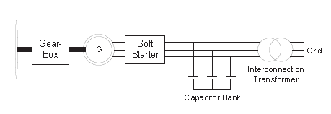
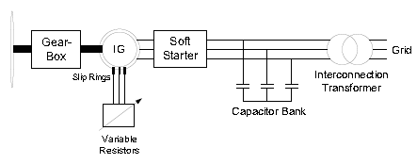
Different Types Of Wind Generation Systems
Fixed Speed Wind Turbine (FSWT) with induction generator
Variable Speed Wind Turbine (VSWT) with variable rotor resistance

Slide 4
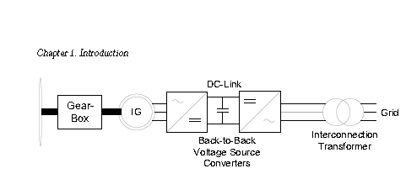
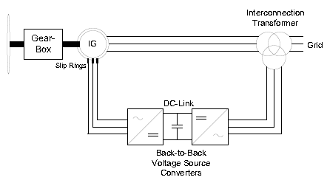
VSWT with Doubly-Fed Induction Generator (DFIG)
VSWT with Full-Power Converter (FPC)

Slide 5


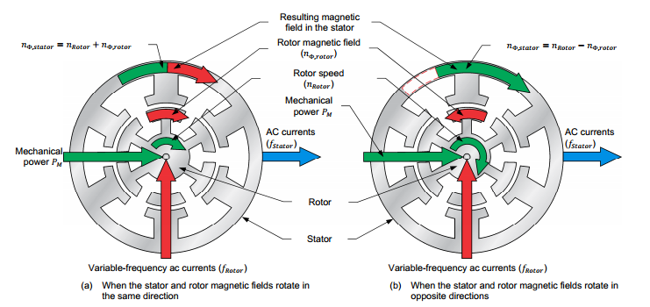
Principle of Operation of DFIG

Slide 6
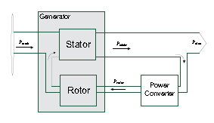
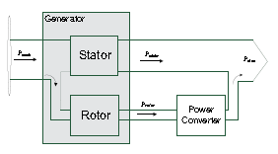
Power Flow in DFIG
Sub-Synchronous Operation
Super-Synchronous Operation

Slide 7
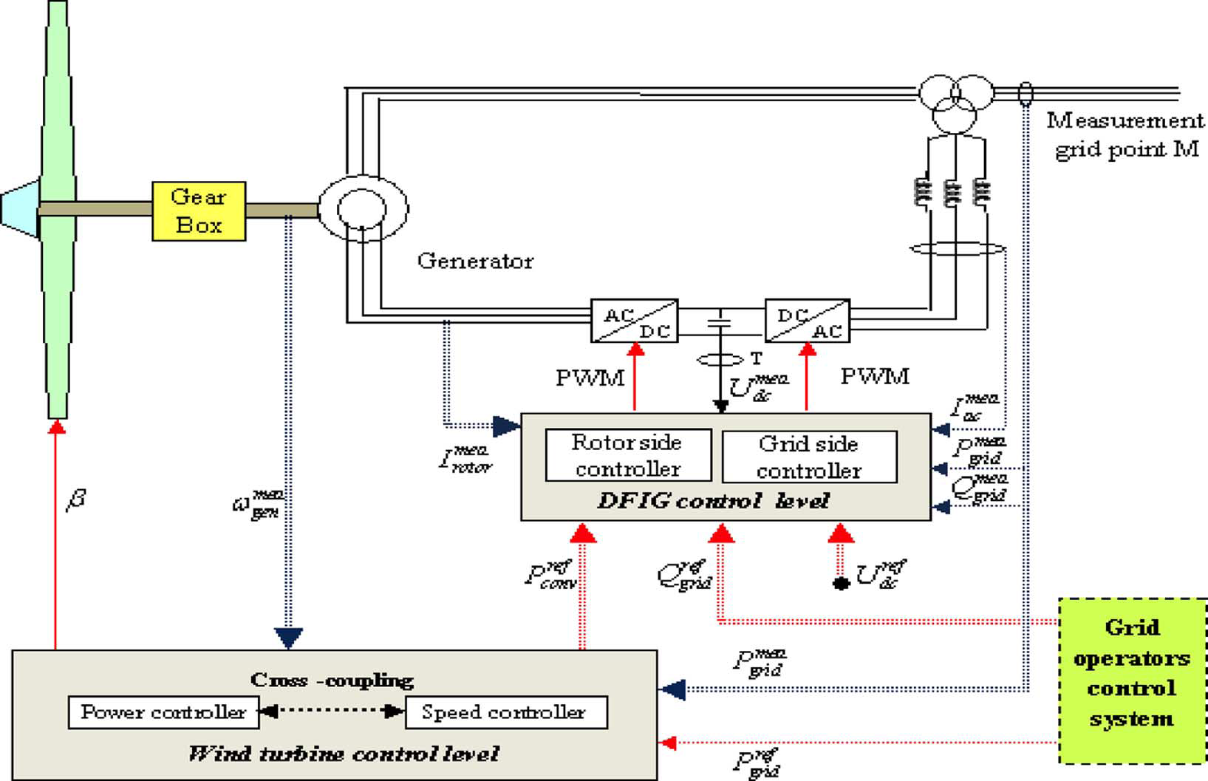
DFIG Electrical and Mechanical Structure

Slide 8
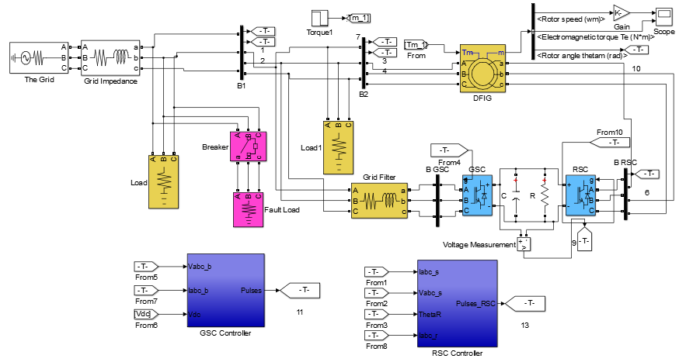
DFIG System in Simulink

Slide 9
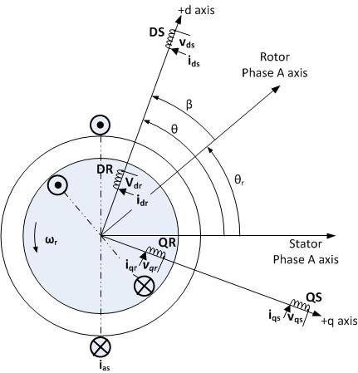
Concept of Vector Control
The main objective is to emulate the drive system of a separately excited DC Machine, which has a natural decoupled control for field and torque currents

Slide 10
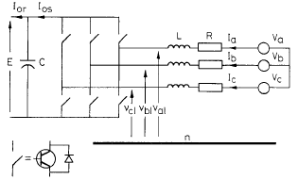

GSC Vector Control
Functions of the GSC:
To maintain the DC link voltage constant
To allow bi-directional power flow
To maintain unity PF
dq-Transformation:
d-axis aligned with supply side voltage space vector
Result of Transformation:
d-axis I controls the dc-link voltage
q-axis I controls the reactive power from grid

Slide 11


GSC Current Control Loop
GSC Voltage Control Loop

Slide 12
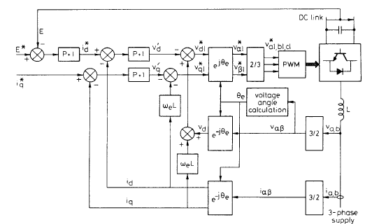
Complete Vector Control Scheme for GSC

Slide 13
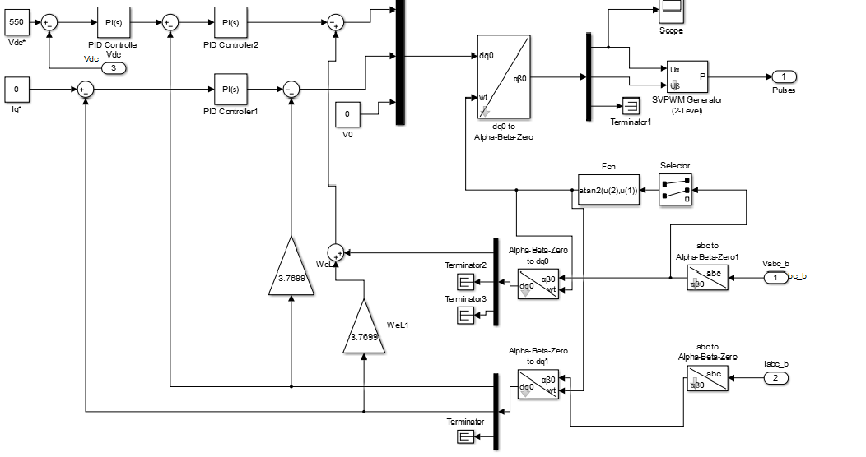
Vector Control Scheme of GSC in Simulink

Slide 14

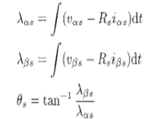

RSC Vector Control
Functions of the RSC:
To control torque or speed
To allow bi-directional power flow
To control rotor excitation current so as to give DFIG reactive power capability
dq-Transformation:
d-axis aligned with stator -flux space vector
Result of Transformation:
d-axis I controls the rotor excitation hence the reactive power
q-axis I controls the speed or torque, hence conrolling the real power

Slide 15


RSC Current Control Loop
RSC Outer Speed Control Loop

Slide 16
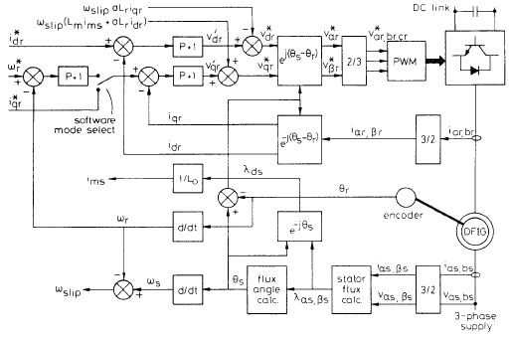
Complete Vector Control Scheme for RSC

Slide 17
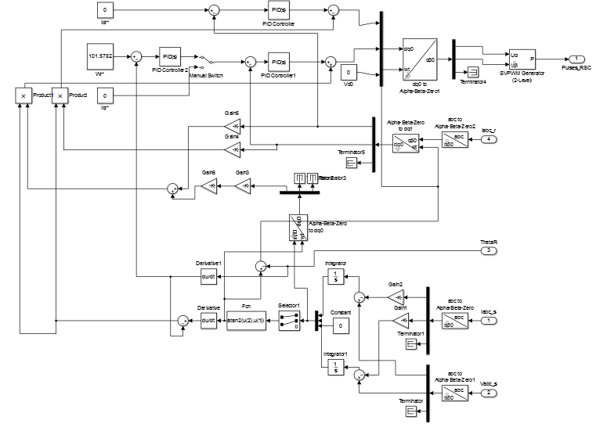
Complete Vector Control Scheme of RSC in Simulink

Slide 18
Advantages of DFIG
Variable speed operation, approx +/- 30% about the synchronous speed, hence maximum power tracking from the turbine system is possible.
With combined control of the GSC and RSC the DFIG does not act as reactive power load, but can even supply reactive power to the grid in times of fault conditions.
The RSC provides for a complete control over the real power output of the DFIG.
Moreover, the converter being in the rotor circuit has to be designed to handle about one-third of the rated power

Slide 19
Thank You

